Slide 1

Demography and Family planning

Slide 2
Frequently asked questions
Long Questions (10 Marks)
Define demography. Discuss demographic cycle.
Explain sources of demographic data in India.
Discuss demographic indicators.
Explain demographic transition and its importance.
Short Notes (5 Marks)
Census
Sample Registration System
Civil Registration System
NFHS
Population pyramid
Dependency ratio
Population explosion
Viva Questions
Who conducts Census?
Difference between Census and SRS?
Which survey provides fertility data?
Full form of CRS?
Which survey provides family planning indicators?

Slide 3
Frequently asked questions
Long Questions
Explain demographic cycle with suitable diagram.
Discuss demographic transition in India.
Explain demographic dividend.
Describe population trends in India.
Short Notes
Population explosion
Replacement fertility
Population momentum
Demographic dividend
Population stabilization
Viva
Which stage is India in?
Define replacement fertility.
What is demographic dividend?
Why does population continue to grow after fertility declines?

Slide 4
Frequently asked questions
Long Questions
Discuss demographic indicators in detail.
Explain vital statistics.
Describe population statistics.
Explain dependency ratio.
Short Notes
Sex ratio
Density of population
Dependency ratio
Literacy rate
Population pyramid
Life expectancy
Viva
Define density.
Formula of dependency ratio.
Sex ratio definition.
Difference between crude and effective literacy.

Slide 5
Frequently asked questions
Long Questions
Discuss family planning programme in India.
Classify contraceptive methods.
Explain spacing and limiting methods.
Short Notes
Family planning
Contraceptive prevalence rate
Antara
Chhaya
PPIUCD
Emergency contraception
Viva
What is the cafeteria approach?
Name temporary contraceptive methods.
Which methods are suitable during breastfeeding?
What is the mechanism of IUCD?

Slide 6
Frequently asked questions
Long Questions
Discuss MTP Act.
Explain MTP Amendment Act 2021.
Discuss National Population Policy 2000.
Explain PCPNDT Act.
Short Notes
MTP
Medical abortion
PCPNDT Act
Consent for MTP
Confidentiality
Medical Board
Viva
Maximum gestational age?
Who can give consent?
Is husband's consent required?
Is MTP a family planning method?

Slide 7
Definition
Scientific study of human population.
It focuses on: (a) changes in population size (growth or decline);
(b) the composition of the population;
(c) the distribution of population in space.
It deals with five “demographic processes”
Fertility, mortality, marriage, migration and social mobility

Slide 8
Importance of demography
Programme | Demographic Data Used
UIP | Population <1 year
RCH | Women (15–49 years)
TB Programme | Population denominator
Family Planning | Eligible couples
NCD Programme | Adult population
Applications
Assess population health needs
Estimate disease burden
Plan health infrastructure
Monitor national health programmes
Allocate manpower and resources
Evaluate health interventions
Support policy formulation

Slide 9
Sources of data
Major Sources
Population Census
Civil Registration System (CRS)
Sample Registration System (SRS) – best source of annual birth rate and death rate
National Family Health Survey (NFHS)
Health Management Information System (HMIS)
National Sample Survey (NSS)
Population projections (Technical Group/NITI Aayog)

Slide 10
Comparison between sources
Source | Frequency | Best Used For | Limitation
Census | Every 10 years | Population count | Infrequent
CRS | Continuous | Legal registration | Incomplete registration in some areas
SRS | Continuous | Birth & death rates | Sample-based
NFHS | Periodic | Fertility, health, nutrition | Survey-based
HMIS | Continuous | Health service statistics | Facility-based
NSS | Periodic | Socio-economic indicators | Sample survey

Slide 11
Demographic transition
Demographic Transition Theory explains how populations change from high fertility and high mortality to low fertility and low mortality with socioeconomic development.
High Birth Rate → Death Rate Falls → Birth Rate Falls → Population Stabilizes → Population Ages

Slide 12
Summary
Stage | Birth Rate | Death Rate | Population
I | High | High | Stable
II | High | Falling | Rapid increase
III | Falling | Low | Increasing
IV | Low | Low | Stable
V | Very Low | Low | Declining

Slide 13
Demographic cycle
First Stage (High stationary): High birth and death rates cancel each other out; population remains stationary (India until 1920).
Second Stage (Early expanding): Death rate declines while the birth rate remains unchanged (Many countries in South Asia and Africa).
Third Stage (Late expanding): Death rate declines further, and birth rate tends to fall, but population grows because births exceed deaths (India has entered this phase).
Fourth Stage (Low stationary): Low birth and death rates lead to a stationary population (Most industrialized countries).
Fifth Stage (Declining): Population declines because the birth rate is lower than the death rate (Some East European countries).

Slide 14
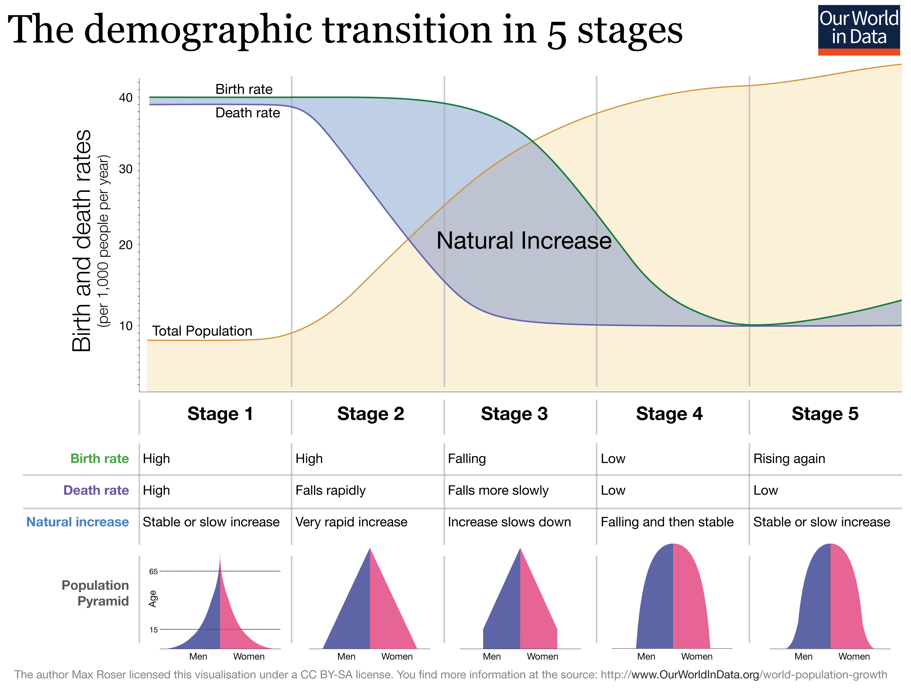

Slide 15
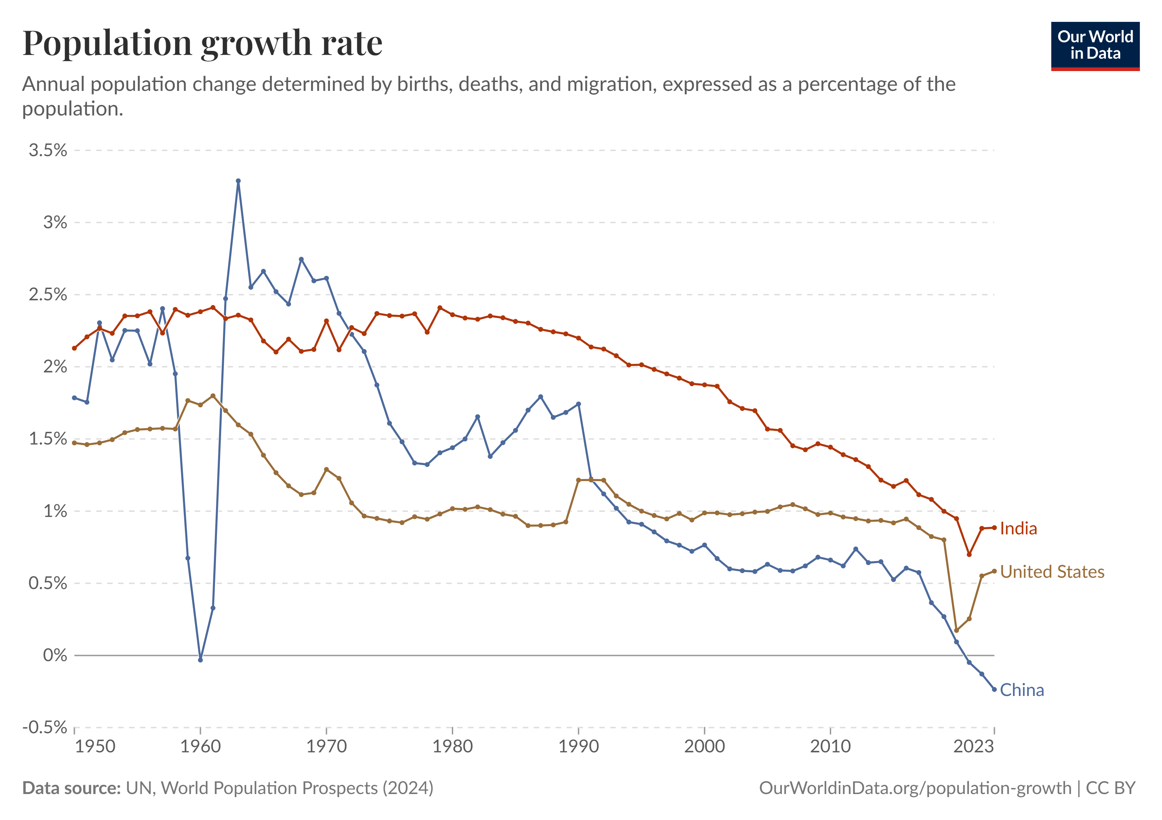
Population growth rate

Slide 16
Population explosion
Definition
Rapid increase in population beyond the carrying capacity of available resources.
Causes
Declining mortality
High fertility
Population momentum
Improved health services
Early marriage
Consequences
Poverty
Unemployment
Malnutrition
Housing shortage
Environmental degradation
Pressure on health services

Slide 17

Population Momentum
Continued population growth despite declining fertility, due to a large proportion of people in the reproductive age group
Replacement Fertility
Average number of children required for a generation to replace itself.
≈ 2.1 children per woman
Why Not Exactly Two?
Additional births compensate for
Child mortality
Female mortality before reproduction

Slide 18
Population stabilization
Population stabilization occurs when births approximately equal deaths and migration has minimal effect, resulting in little or no long-term population growth.
Achieved By
Female education
Delayed marriage
Family planning
Improved child survival
Economic development
Government Goal
Population stabilization through voluntary and informed choice.

Slide 19
Population Pyramid
Definition
Graphical representation of the age and sex distribution of a population.
Types
Expansive
Stationary
Constrictive
Uses
Assess dependency
Predict future growth
Health planning
Compare countries

Slide 20
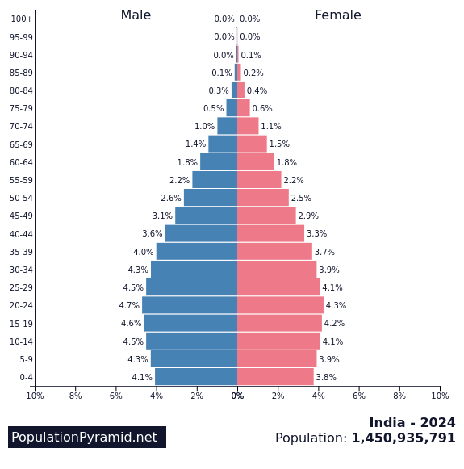
Population pyramid - India
Characteristics
Broad base (gradually narrowing)
Large working-age population
Increasing elderly population
Interpretation
Declining fertility
Demographic dividend
Future ageing

Slide 21
Demographic dividend
Economic growth resulting from an increasing proportion of working-age population.
Requirements
Education
Skill development
Employment
Women's workforce participation
Good health
Opportunity
Time-limited "window of opportunity."
Demographic dividend is not automatic; it requires investment in human capital. Challenges to India's Demographic Dividend
Youth unemployment
Skill mismatch
Gender inequality
Poor labour-force participation of women
Regional disparities
Population ageing
Demographic dividend can become a demographic burden if adequate jobs are not created.

Slide 22
Demographic indicators
Demographic indicators are statistical measures that describe the size, composition, distribution and health status of a population.
Uses
Compare populations
Monitor health programmes
Assess development
Evaluate policies
Plan health services
Classification
Population Statistics
Vital Statistics
Population statistics describe who the people are.
Vital statistics describe events occurring in the population.

Slide 23
Classification of Demographic Indicators
Population Statistics
Population size
Age
Sex
Density
Literacy
Urbanization
Dependency
Life expectancy
Vital Statistics
Birth rate
Death rate
Fertility
Mortality

Slide 24
Population statistics
Population Size
Total number of people living in a defined geographical area at a specified point in time.
India is currently the most populous country in the world, having surpassed China according to recent UN estimates.
Age Composition
Distribution of population according to age groups.
Common Age Groups
0 – 14 → Children
15 – 64 → working
>= 65 → Elderly

Slide 25
Sex Composition
Distribution of males and females in a population.
Sex Ratio
Females per 1000 males
Reflects
Women's status
Gender discrimination
Female survival
Health system performance
Causes of Low Sex Ratio
Sex-selective practices
Female foeticide
Poor female nutrition
Gender bias
Migration
Child Sex Ratio
Number of girls (0–6 years) per 1000 boys (0–6 years)
Sensitive indicator of
Sex selection
Gender discrimination
Future demographic imbalance
Causes of Decline
Prenatal sex determination
Female foeticide
Neglect of girl child
Closely linked with implementation of the PCPNDT Act.

Slide 26
Population statistics
Population Density
Number of persons living per square kilometre.
Formula
Population / Land Area
Higher density increases risk of rapid spread of communicable diseases.
Dependency Ratio
Ratio of dependent population to working-age population.
Formula
(0–14 years + ≥65 years)*100/ 15–64 years
Types
Total dependency ratio
Young dependency ratio
Old-age dependency ratio
Clinical Importance
Pension planning
Elderly care
Child welfare programmes

Slide 27
Population statistics
Literacy Rate
Percentage of persons aged 7 years and above who can read and write with understanding.
Types
Crude Literacy Rate
Effective Literacy Rate
Literacy and Health
Higher literacy is associated with
Lower fertility
Better immunization
Lower maternal mortality
Better sanitation
Improved nutrition
Better health awareness
Female literacy is one of the strongest determinants of fertility decline.
Urbanization
Increase in proportion of population living in urban areas.
Advantages
Better education
Better healthcare
Employment
Challenges
Slums
Pollution
Overcrowding
Lifestyle diseases

Slide 28
Life expectancy
Average number of years a newborn is expected to live if current mortality patterns continue.
Indicator of
Health status
Development
Quality of healthcare
Factors Affecting
Nutrition
Healthcare
Sanitation
Income
Education

Slide 29
Vital statistics
Birth rate (crude birth rate)
Number of live births occurring during one year per 1000 mid-year population.
Death Rate (Crude Death Rate)
Number of deaths occurring during one year per 1000 mid-year population.
Natural Growth Rate
Difference between birth rate and death rate.
Natural Growth Rate = Birth Rate − Death Rate

Slide 30
Fertility
Influenced By
Age at marriage
Education
Contraception
Breastfeeding
Nutrition
Religion
Socioeconomic status

Slide 31
Fertility Indicators
General Fertility Rate (GFR)
Number of live births per 1000 women aged 15–49 years.
Live births*1000 / Women aged 15–49 years
Advantage
Better indicator than CBR because only women of reproductive age are included.
Limitation
Includes all women 15–49 years, irrespective of marital status.
General Marital Fertility Rate (GMFR)
Number of live births per 1000 married women aged 15–49 years.
Live births *1000 / Married women (15–49 years)
Importance
Better estimate of fertility where childbirth mainly occurs within marriage.
Age-Specific Fertility Rate (ASFR)
Number of live births among women in a specific age group per 1000 women of the same age group.
Identifies high-risk reproductive ages.
Used to calculate TFR.
Evaluates family planning programmes.

Slide 32
Fertility Indicators
Total Fertility Rate (TFR)
Average number of children a woman would have during her reproductive life if current age-specific fertility rates remain constant.
Importance
Most useful indicator of fertility.
India has achieved replacement-level fertility nationally, though state-level differences persist.
Gross Reproduction Rate (GRR)
Average number of daughters born to a woman during her reproductive life, assuming no female mortality.
Measures replacement of mothers by daughters.
GRR considers only female births.
Mortality not considered.
Net Reproduction Rate (NRR)
Average number of daughters born to a newborn girl during her lifetime after considering female mortality.
Interpretation
NRR = 1 ➔ replacement achieved
NRR >1 ➔ Population inc
NRR <1 ➔ Population dec
NRR = 1 corresponds approximately to replacement fertility.

Slide 33
Family Planning
Family planning means the ability of individuals and couples to anticipate and attain their desired number of children and the spacing and timing of births.
Objectives
Improve maternal health
Reduce infant mortality
Prevent unintended pregnancy
Promote small family norm
Support population stabilization

Slide 34
Evolution of the program
Phase | Major Features
1952 | First national programme launched
1960s–70s | Target-oriented approach
1970s–80s | Sterilization emphasis
1996 | Reproductive and Child Health (RCH)
2005 | National Rural Health Mission
Present | RMNCH+A and Mission Parivar Vikas
Programme Goals
Short-Term
Reduce unmet need
Improve access to contraceptives
Promote spacing methods
Long-Term
Achieve replacement-level fertility
Improve maternal and child health
Stabilize population
Strategy
Voluntary, informed choice through a cafeteria approach

Slide 35
Cafeteria approach
A contraceptive service delivery approach in which a wide range of methods is offered so that couples can choose the method best suited to them.
Respects client choice
Improves acceptance
Increases continuation
Reduces unmet need

Slide 36
Mission Parivar vikas
To improve access to contraceptives and family planning services in high-fertility districts.
High-fertility districts
Improved spacing methods
Counseling
Quality services

Slide 37
Counselling for contraception
Principles
Respect privacy
Give complete information
Offer method choice
Discuss side effects
Encourage follow-up
Counsel on
Effectiveness
Reversibility
Side effects
STI protection
When to return

Slide 38
Abortion terminology
Term | Meaning
Abortion | Expulsion of products of conception before fetal viability
Spontaneous abortion | Miscarriage
Induced abortion | Intentional termination
Medical abortion | Drugs used
Surgical abortion | Instrumental evacuation
MTP refers only to legally permitted induced abortion.

Slide 39
Safe Abortion
Unsafe abortion contributes to
Maternal mortality
Hemorrhage
Sepsis
Infertility
Uterine injury
Public Health Goal
Provide
Safe
Legal
Accessible
Respectful abortion care
Safe abortion is an important component of reproductive healthcare.

Slide 40
MTP act
Up to 20 weeks
Opinion of one Registered Medical Practitioner (RMP) is required for eligible cases.
20–24 weeks
Opinion of two Registered Medical Practitioners (RMPs) is required for specified categories of women.
Beyond 24 weeks
Allowed only for substantial fetal abnormalities, as diagnosed by a Medical Board, according to the Act and applicable rules.

Slide 41
Indications of MTP
Therapeutic
Continuation endangers mother's life.
Eugenic
Substantial fetal abnormalities.
Humanitarian
Pregnancy due to rape or incest.
Social
Failure of contraception causing mental distress in eligible women as recognized under the Act.
Public Health Importance
Reduces unsafe abortion.

Slide 42
Eligible Categories (20–24 Weeks)
Survivors of rape
Minors
Change in marital status during pregnancy (e.g., widowhood or divorce)
Women with physical disabilities
Women with mental illness
Cases of fetal anomalies
Humanitarian/disaster situations as notified

Slide 43
Consent and confidentiality
Adult Woman (≥18 years)
Only her own written consent is required.
Minor (<18 years)
Consent of guardian.
Woman with Mental Illness (where applicable under the law)
Guardian's consent.
The Act mandates confidentiality.
Identity of the woman → Cannot be disclosed → Except as permitted by law.

Slide 44
Method
Medical
Mifepristone
Misoprostol
Surgical
Vacuum aspiration
Dilatation and evacuation (D&E), depending on gestational age and clinical indication
Choice Depends On
Gestational age
Clinical condition
Facility
Provider expertise

Slide 45
Complications
Immediate
Bleeding
Infection
Incomplete abortion
Uterine injury
Late
Asherman syndrome (rare)
Infertility (rare after safe abortion)
Prevention
Safe abortion by trained providers.

Slide 46
Thanks

